Slide 1
0x201 – What Security Gives Us
ECED4406 – Computer Security
Dr. Colin O’Flynn
Dalhousie University.

Slide 2


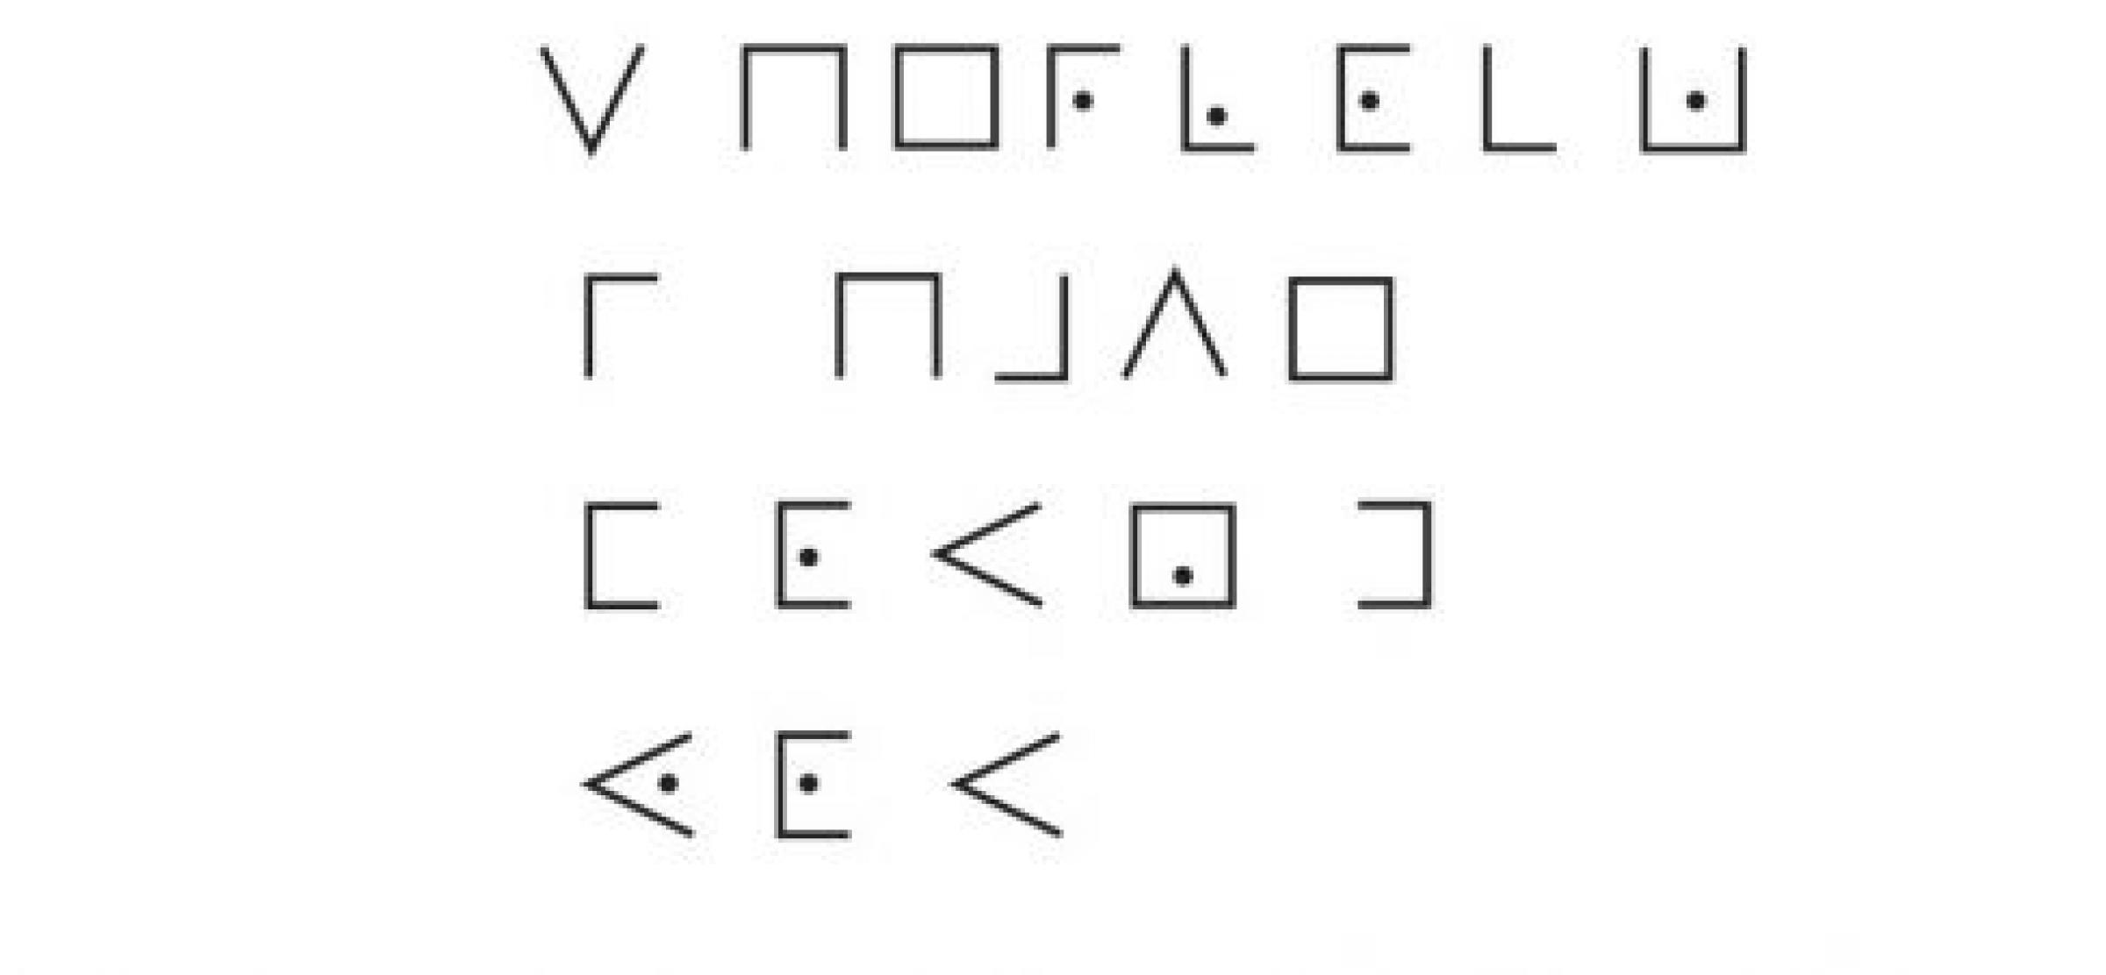
Confidentiality
Probably what you think of with “security”. Prevents someone from reading your messages.

Slide 3
Integrity
Data protected by unauthorized modifications.
We can have integrity without confidentiality.

Slide 4
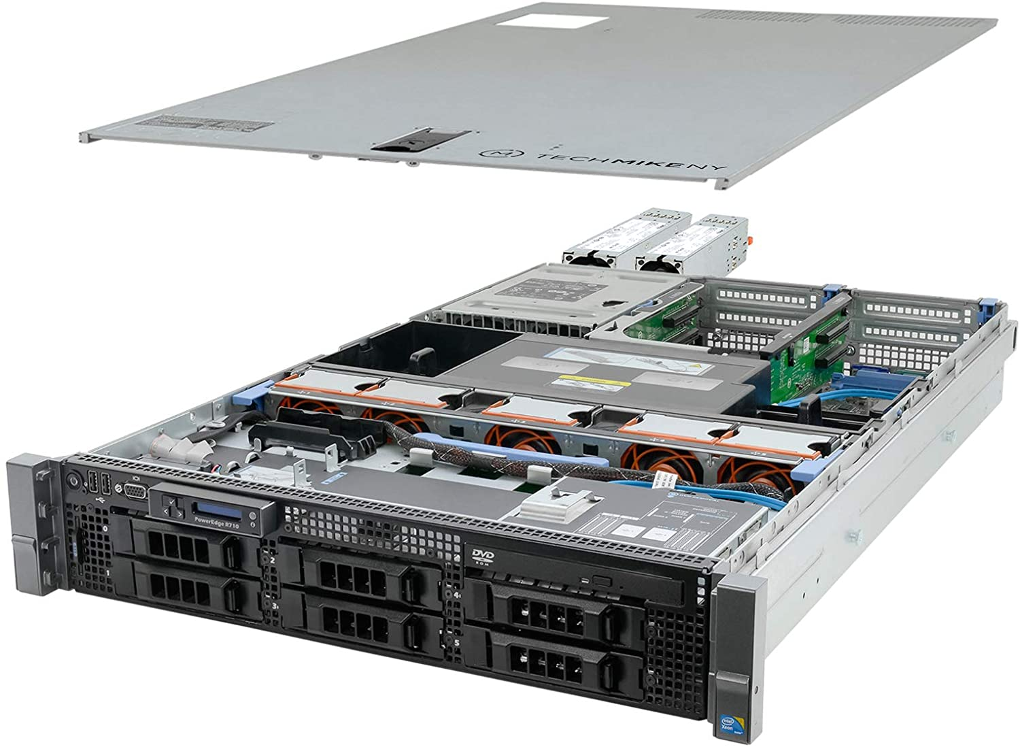
Availability
System should remain available for user.
Unhackable server (not plugged in).
Cryptography isn’t concerned with availability, but often a critical part of overall security.

Slide 5
Non-repudiation
Cannot deny later having sent messages that you sent.
Often a complex question – can
you claim someone stole the secret
key you use?
See – everyone who claims their
Twitter account was “hacked”
after posting something…

